Slide 1

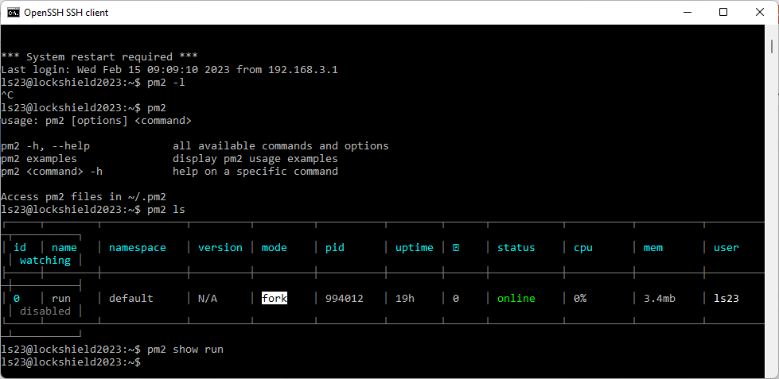
PM2 Charging mode [ Basic ]
Only install PM2 : only can monitor the task by cmd line.

Slide 2
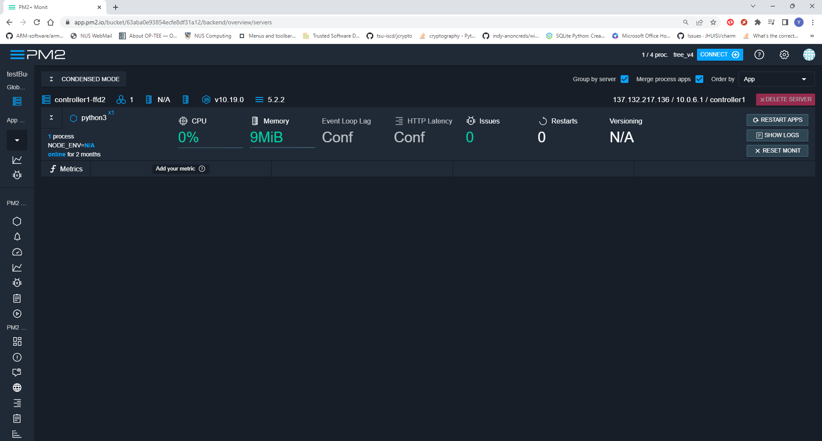
PM2 Charging mode [ Registered ]
Register account and accept PM2 message pull:
Max monitor 4 nodes, each not can monitor max 10 tasks.
Only monitor CPU, memory and basic info shown on dashboard.

Slide 3
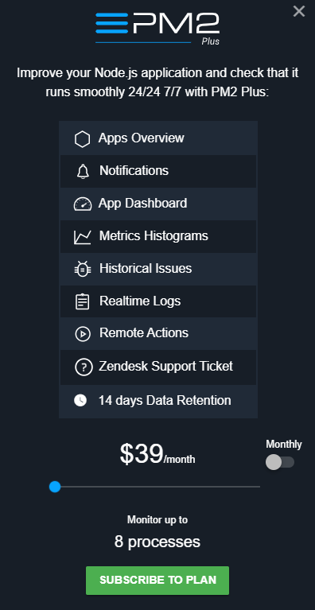
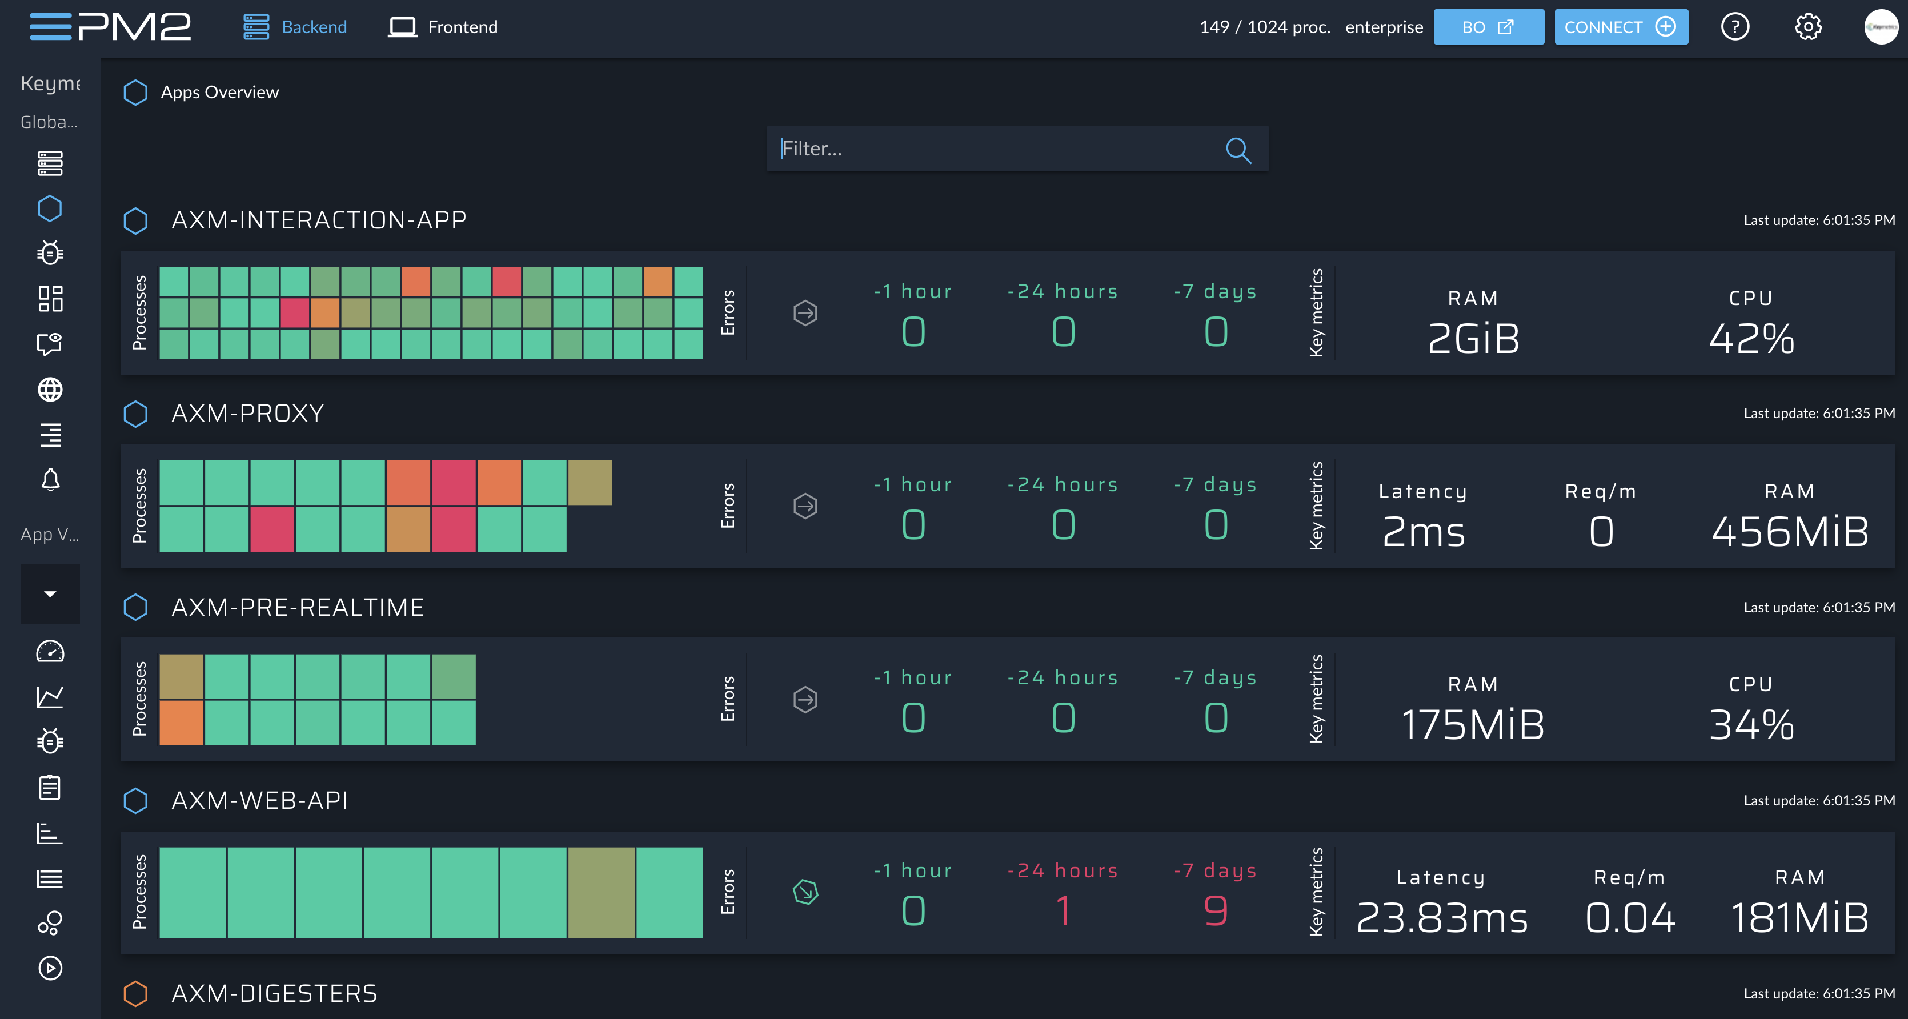
PM2 Charging mode [ Plus+ ]
Buy PM2 plus [$39/month]:
Max monitor 1024 nodes, no limited tasks.
Apps overview in dashboard: app centric overview across all your servers
Notifications:
Metrics Histograms: Monitor inputs, outputs and processings.
Historical Issues: Error tracking that helps monitor and fix crashes in real-time
Realtime Logs: Consult logs of all your applications in real-time within the same interface.
Remote Actions: Restart, Reload, Reset your application from dashboard interface

Slide 4
PM2 Charging mode [ Enterprise ]
Buy PM2 Enterprise [Submit the quotation form]:
All the PM2 Plus features and additional l new feature :
Dashboards: The perfect sidekick for PM2 Plus' overview.
Anomalies: Automatically detect metrics behavior correlation, detect unexpected anomalies. This feature is in R&D.
Alerting: Create your own alerts by setting different type of threshold on any metrics. Automatically trigger emails, slack notifications, webhooks, custom actions or SMS.
Webchecks: Visualize your network topology and health.
Distributed Tracing: Make your API faster. Detect which API route is slow, Identify slow database queries or 3rd party service interactions. Monitor API status code over time.
Historical Logs: Stop going back and forth to your servers and display your applications logs directly in your browser.
CPU Profiling:
Memory Profiling: Trigger a Memory profiling of your app on one or more servers
Memory Snapshot: Trigger a Memory snapshot of your app on one or more servers.

